Slide 1

Development of Embedded system for Carbon Nano tube (CNT) based Ammonia (NH3) Gas Sensor
By
DHARMENDRA KUMAR SHARMA,
MAYANK RAJPUT , ANIL KUMAR, S.A. AKBAR
CSIR-Central Electronics Engineering Research Institute, Pilani -333031
pvlr@ceeri.ernet.in
Presented at
12th IEEE India International Conference INDICON 2015, E3-C3 17-20 December, Jamia Milia Islamia, New Delhi, India
1

Slide 2
Introduction
Embedded system for gas concentration measurement of a sensor chip using in-house developed carbon nanotube (CNT) based gas sensor and characterization of packaged device in an ambient.
NH3 response at different concentrations and with experimental results is reported in this work.

Slide 3
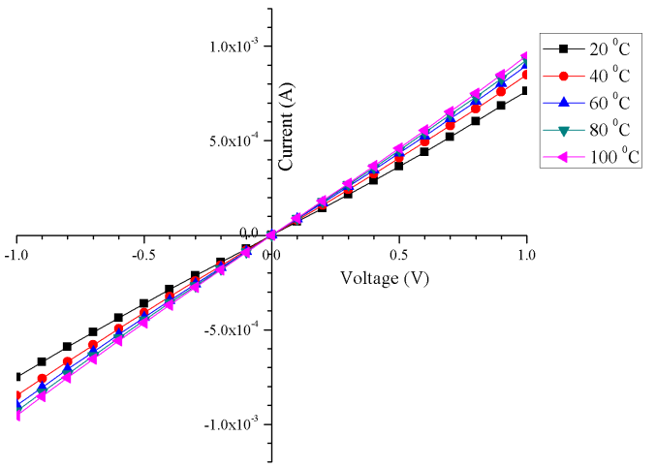
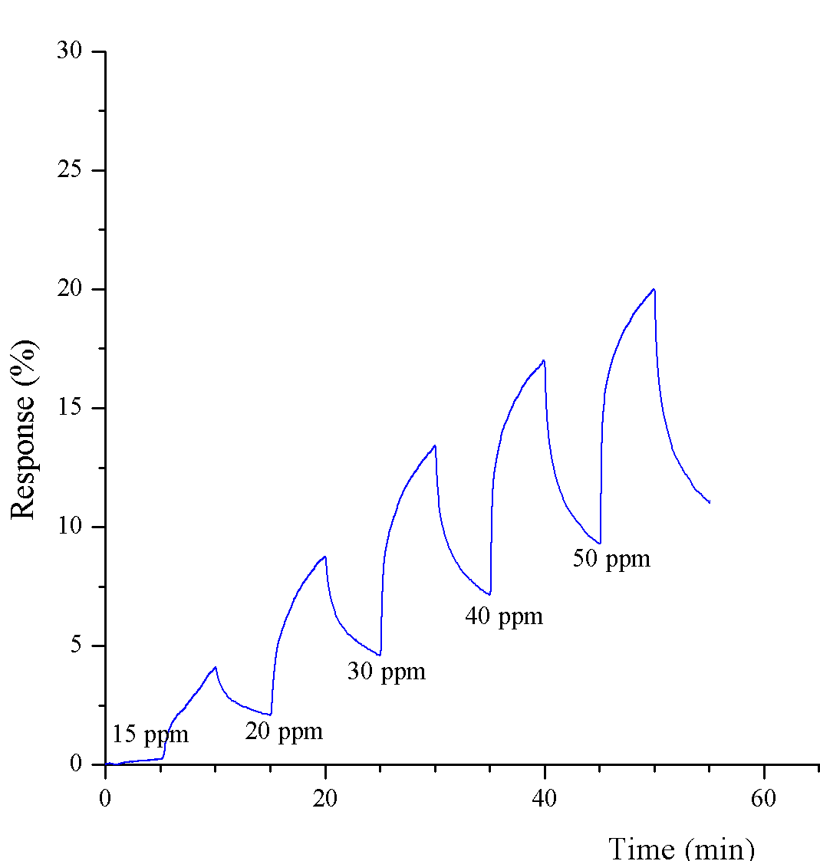
Fabrication and Characterization of SWCNT based NH3 gas sensor
Gas sensor chip has been fabricated and characterized in past and reported up to 50 ppm. [1]
Figure-1: I-V characteristics of functionalized SWCNT Chemiresistor
Figure-2: Response vs Time of NH3 gas sensor [15ppm-50ppm]

Slide 4
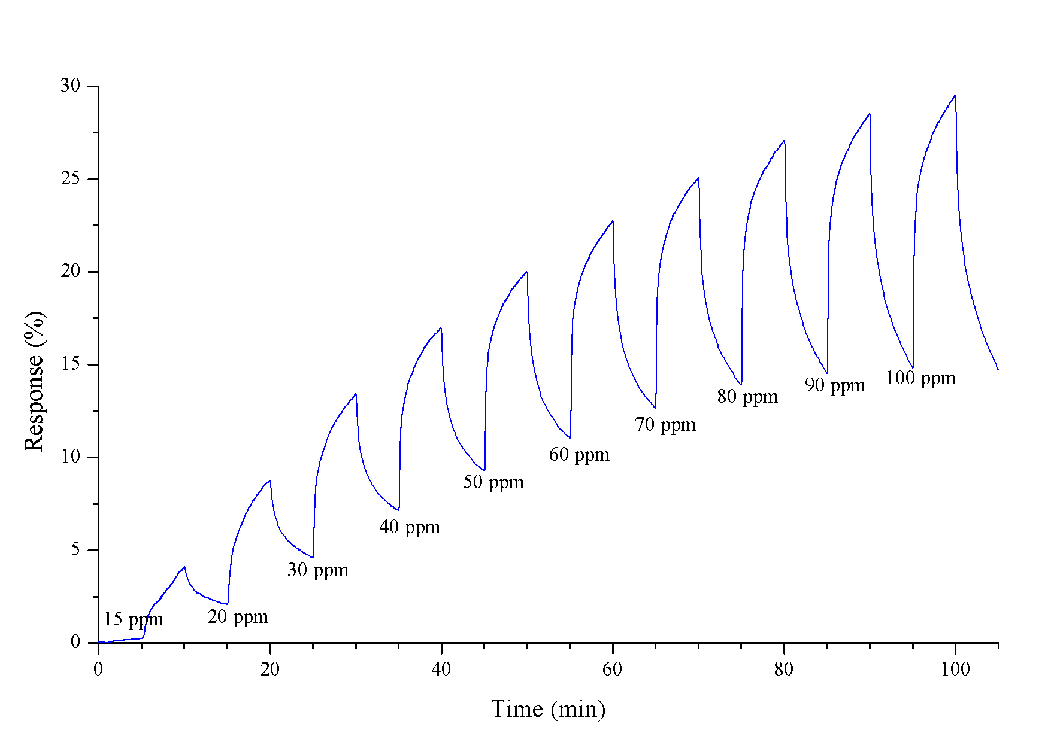
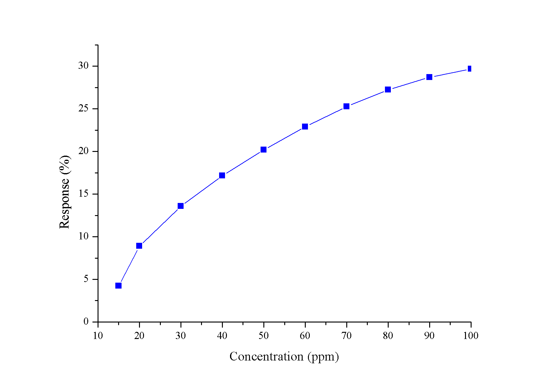
Continue…
To get more data the same sensor has been characterized till 100ppm
Figure-3: NH3 sensitivity (%) vs time (min.) Figure-4 (a): Sensitivity vs NH3 ppm
The final feature of the characterized NH3 gas sensor are given as follows,
1. | Target Gas | NH₃
2. | NH3 measurement | 15ppm-100ppm
3. | Operating Temperature | 25 ºC
y = -1E-05x³ + 0.0005x² + 0.3026x - 0.724
….(1)
Eq.(1) Resistance(%) vs Concentration curve

Slide 5
Continue…
r_p % | NH3 (ppm)
0 | 0
2.1775 | 15
5.403 | 20
9 | 30
12.0645 | 40
14.645 | 50
16.871 | 60
18.871 | 70
20.484 | 80
21.716 | 90
23.7 | 100
Figure-4 (b): NH3 ppm vs Sensitivity
….(2)
Table 1: Characterization Results
Eq.(2) Concentration vs Resistance(%) curve

Slide 6
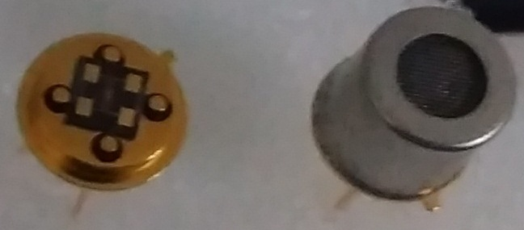
Packaging of NH3 sensing chip for real time testing
For the packaging of the sensor chip, gold wire bonding (diameter 25 µm.) of the sensor on TO-39 packages has been done using West Bond wire bonding machine as shown in figure-5,
Figure-5: Gold wire bonded gas sensor in TO-39 packaged uncovered (left) and covered (right)

Slide 7
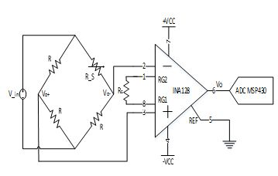
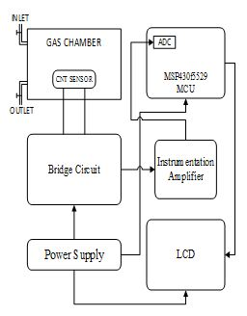
Embedded System Design for NH3 Gas Sensor
Figure-6: Proposed Bridge Circuit Interface
Equation (1) is implemented in microcontroller
to find the gas sensor resistance value R_S,
….(3)
Figure-7: Block diagram of hardware setup of the gas measurement system along with the gas sensor
Equation (2) shows the characteristic equation in form
of percent change in resistance (sensitivity),
….(4)

Slide 8
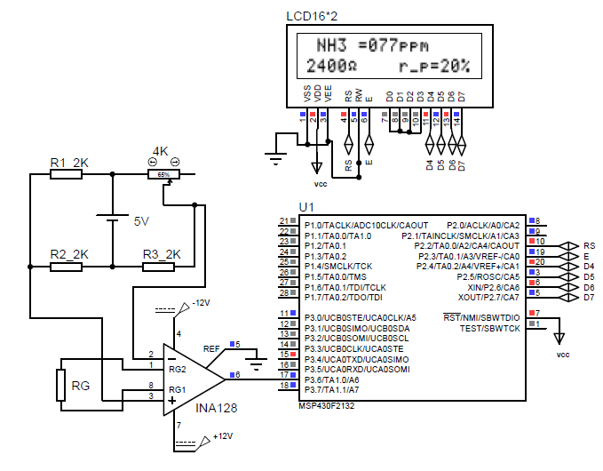
Proposed Embedded System Simulation
The system simulation is done using the Labcentre Proteus using the available microcontroller MSP430G2132.
The validity of the system is verified by the varying the resistance of the potentiometer as a model the gas sensor.
Figure-8: System simulation using the Labcentre Proteus software

Slide 9
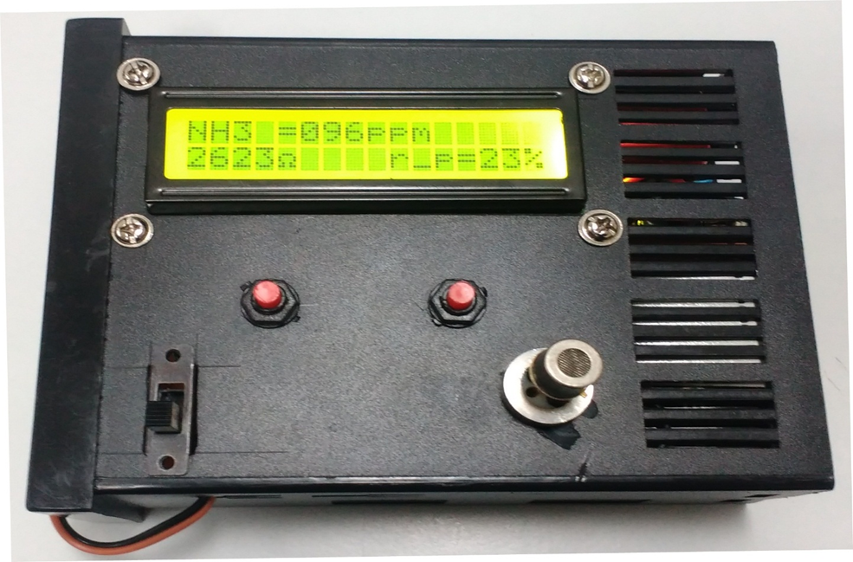
Developed Prototype and Testing of Packaged NH3 gas sensor
Figure-9: Signal conditioning circuit prototype of the gas measurement system along with the packaged NH3 gas sensor
and its response after drop-casting of Ammonia solution drops near the sensor in an open ambient

Slide 10
Results and Discussion
The characteristics equation is implemented in microcontroller and it reproduces the characteristics when discrete resistance are connected.
Average filter is implemented for noise cancellation in ADC.
The circuitry measurers the resistance with an accuracy of 1%.

Slide 11
Conclusion and Future work
The increase in sensitivity (r_p %) with the ammonia (NH3) concentration we can suggest that the ammonia molecules act as a donor doping to the SWCNT which has a p-type semiconductor character.
SWCNTs shows increase in sensitivity with the increase in ammonia concentration level.
In this project, portable prototype for SWCNT based NH3 gas sensor has been successfully developed. The LCD displaying functional characteristics satisfies all definitions of our CNT gas sensor.
The developed signal conditioning circuit of SWCNT based NH3 gas sensor is a proto-type, made considering minimum system requirement and this work have interminable possibilities for further up-gradation like working as wireless sensing node.

Slide 12
Acknowledgement
Authors would like to acknowledge Dr. Chandra Sekhar, Director, CSIR-CEERI, Pilani for his continuous support and encouragement. This work has been carried out under CSIR 12th Five Year Plan Network Project R-Nano (PSC-0102), financial support is duly acknowledged.

Slide 13
References
Bala Sekhar Dasari, William R. Taube, Pankaj B. Agarwal, Mayank Rajput, Anil Kumar, Jamil Akhtar, “Room Temperature Single Walled Carbon Nanotubes (SWCNT) Chemiresistive Ammonia Gas Sensor" in Sensors and Transducers, Vol. 190, Issue 7, July 2015, pp. 24-30
M. Mittal, A. Kumar, Carbon nanotube (CNT) gas sensors for emissions from fossil fuel burning, Sensors and Actuators B: Chemical, Volume 203, November 2014, Pages 349-362, ISSN 0925-4005
Shu Peng, Kyeongjae Cho, “Ab Initio Study of Doped Carbon Nanotube Sensors”, Nano Letters, 3 (4), pp 513–517, 2003
Robinson JA, Snow ES, Reinecke TL, Perkins FK, “Ab initio study of Pd-decorated single-walled carbon nanotube with C-vacancy as CO sensor”, NanoLett, 6:1451–1747, 2006
De Marcellis, A.; Ferri, G.; Mantenuto, P.; Giancaterini, L.; Cantalini, C., "Hydrogen Resistive Gas Sensor and Its Wide-Range Current-Mode Electronic Read-Out Circuit," in Sensors Journal, IEEE , vol.13, no.7, pp.2792-2798, July 2013
J. Millan, “Voltage Divider and Wheatstone Bridge", [Online]; Available: http://www.engr.mun.ca/~millan/lab1.pdf
Islam, T.; Khan, A.U.; Akhtar, J., "Accuracy analysis of oscillator-based active bridge circuit for linearly converting resistance to frequency," in Multimedia, Signal Processing and Communication Technologies (IMPACT), 2013 International Conference on , vol., no., pp.305-309, 23-25 Nov. 2013

Slide 14
Thankyou

Slide 15
Queries

